Slide 1
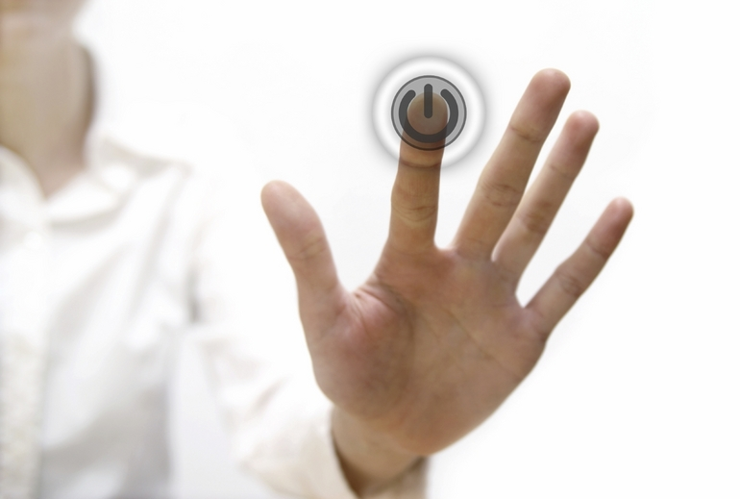
Biometrics: Overview, Challenges and Future Vision
Presented to
Professor Abdulmotaleb El Saddik
by
Faisal Arafsha
Hikmat El Ajaltouni
ELG 5121
Multimedia Communications
School of Information Technology and Engineering
University of Ottawa

Slide 2
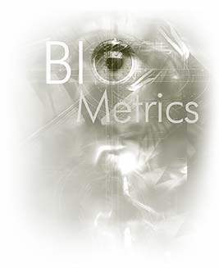
Outline
Introduction
Biometrics Defined
Biometric System Implementation
Primary Driving Forces
Types of Biometrics
Challenges & Threats
Promises and Future Work
Conclusion

Slide 3
Introduction
Biometry (Greek words) = ‘bios’ (life) and ‘metron’ (measure)
In a broader sense, biometry = measurement of body characteristics
In second half of the 20th century biometrics has given a second meaning:
“ automated methods and techniques that analyze human characteristics in order to verify a person, or identify this person from another, based on a physiological or behavioral characteristic.”

Slide 4
Major Milestones in the History of Biometrics
Year | Description
1858 | First systematic capture of hand images for identification purposes is recorded
1896 | Henry develops a fingerprint classification system
1903 | NY State Prisons begins using fingerprints
1960 | First model of speech recognition is created
1991 | Face Recognition Possible
1992 | Biometric Consortium established within US government
1995 | Iris recognition becomes available as a commercial product
1996 | Biometric Standards
2003 | European Biometrics Forum established
2005 | Iris on the move

Slide 5
Outline
Introduction
Biometrics Defined
Biometric System Implementation
Primary Driving Forces
Types of Biometrics
Challenges & Threats
Promises and Future Work
Conclusion

Slide 6
Biometrics
The security field uses 3 different types of identification:
Something You Know — a password, PIN, or piece of personal information (such as your mother's maiden name)
Something You Have — a card key, smart card, or token (like a SecureID card)
Something You Are — a biometric
Biometric = most secure and convenient authentication tool.
It can't be borrowed, stolen, or forgotten, and forging one is practically impossible.

Slide 7
Characteristics of a Biometric
If a biological, physiological, or behavioral characteristic has the following properties:
Uniqueness
Universality
Permanence
Measurability
….then it can potentially serve as a biometric for a given application.

Slide 8
Outline
Introduction
Biometrics Defined
Biometric System Implementation
Primary Driving Forces
Types of Biometrics
Challenges & Threats
Promises and Future Work
Conclusion

Slide 9
Biometric System Implementation
Biometric identification systems = pattern recognition systems
Use acquisition devices (cameras and scanning devices to capture images, recordings, or measurements of an individual’s characteristics) and computer hardware and software to extract, encode, store, and compare these characteristics.
Depending on the application, biometric systems can be used in one of two modes:
Verification (authentication)
Identification

Slide 12
Biometric Standards
Specify:
Common file formats that provide platform independence and separation of transfer syntax from content definition
Technical Interfaces
Data Interchange Formats
Performance Testing and Reporting
Others
Who develops the Standards?
National Institute of Standards and Technology
International Committee for Information Technology Standards (INCITS)
Joint Technical Committee 1 (JTC1)/Subcommittee 37 (SC 37)
Organization for the advancement of Structured Information Standards (OASIS)

Slide 13
Outline
Introduction
Biometrics Defined
Biometric System Implementation
Primary Driving Forces
Types of Biometrics
Challenges & Threats
Promises and Future Work
Conclusion

Slide 14
Biometrics Task Force Movie

Slide 15
Primary Driving Forces
In a broader sense Biometrics have a critical role in:
National Security
Homeland Security and Law enforcement
Enterprise and e-government services
Personnel info and business transactions
All uses extend from 3 basic needs:
Physical Security: Access to a physical location such as a building or room.
Cyber Security: Access to a network through a biometrically authenticated login schema.
Transactional Security: Any monetary transaction which biometrically authenticates, accesses, and atomically debits or credits the user’s account.
National Science and Technology Council Office of the president of US Aug.2006

Slide 16
Outline
Introduction
Biometrics Defined
Biometric System Implementation
Primary Driving Forces
Types of Biometrics
Physiological
Behavioral
Challenges & Threats
Promises and Future Work
Conclusion

Slide 17
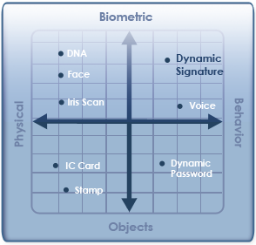
Types of Biometrics

Slide 18
Outline
Introduction
Biometrics Defined
Biometric System Implementation
Primary Driving Forces
Types of Biometrics
Physiological
Behavioral
Challenges & Threats
Promises and Future Work
Conclusion

Slide 19
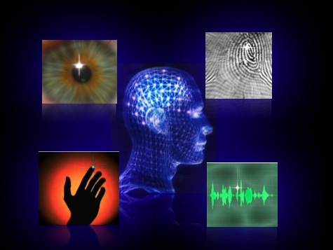

Slide 20
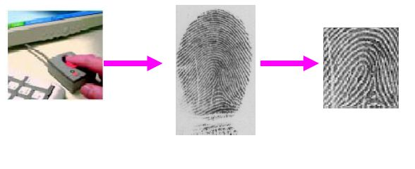
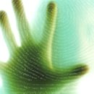
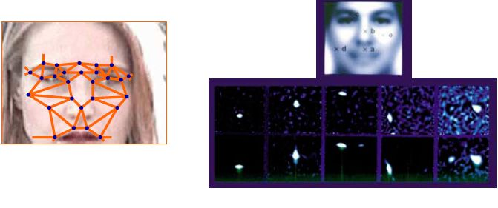
Fingerprint Recognition
Iris / Retinal Recognition
Palm / Hand
Geometry Recognition
Facial Recognition

Slide 21
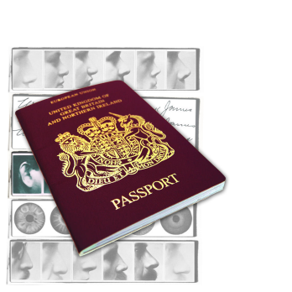
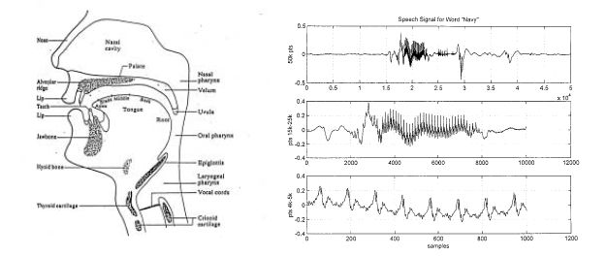
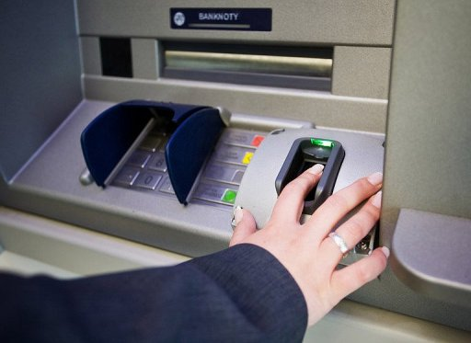
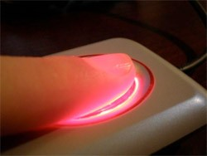
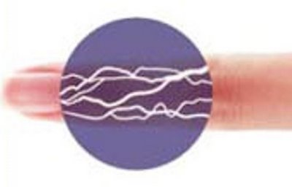
E-Passport
(biometric Passport)
Voice Recognition
DNA Matching
Venial Recognition (Unique Vein Pattern)

Slide 22
Outline
Introduction
Biometrics Defined
Biometric System Implementation
Primary Driving Forces
Types of Biometrics
Physiological
Behavioral
Challenges & Threats
Promises and Future Work
Conclusion

Slide 23
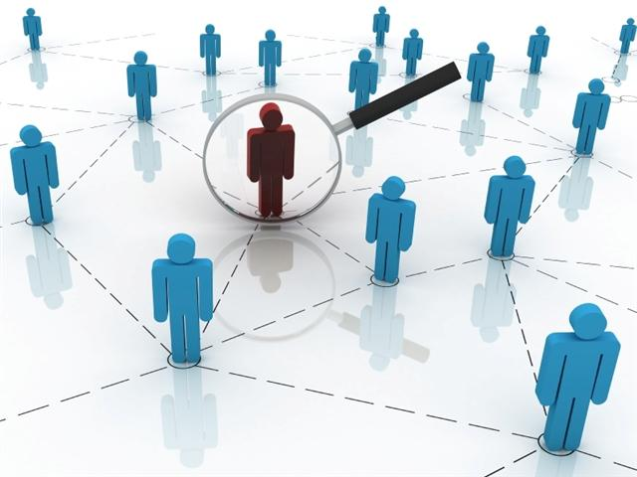
Behavioral Biometrics
Identification and verification based on user behavior
Results are never 100% accurate:
FAR: False Acceptance Rate
FRR: False Rejection Rate
Examples:
Keystroke dynamics
Mouse dynamics
Handwriting dynamics
Analysis of Cardiac Sounds
EEG/ECG
Gait recognition

Slide 24
Keystroke Dynamics I
Mostly used when continuous verification is applied
Can also be used as an extra security measure when entering username and password
Dynamics monitored:
Interval (or negative interval)
Latency
Dwell time
Flight time and Up-to-up time
Overall typing speed
Frequency of errors

Slide 25
Keystroke Dynamics II
Interval
Dwell Time
Latency
A
B
A
A
B
Time
Time
Time
Flight Time
Up-to-up Time
A
B
A
B
Time
Time
R. Moskovitch, C. Feher, A. Messerman, N. Kirschnick, T. Mustafic, A. Camtepe, B. Lohlein, U. Heister, S. Moller, L. Rokach, and Y. Elovici, “Identity Theft, Computers and Behavioral Biometrics,” IEEE Conference on Intelligence and Security Informatics. pp 156, June 2009

Slide 26
Keystroke Dynamics III
Approaches:
Extra security measure at login time
Continuous Verification: If username and password entered correctly, system can allow user in and keep monitoring behaviour → probability of impostor is calculated.
Innovation Contest | Safelock

Slide 27
Mouse Dynamics I
The characteristics of a user’s interaction with a specific GUI
Measurements:
Distance travelled
Duration
Direction
Dynamics monitored:
Mouse movement
Drag and drop
Point and click
Silence

Slide 28
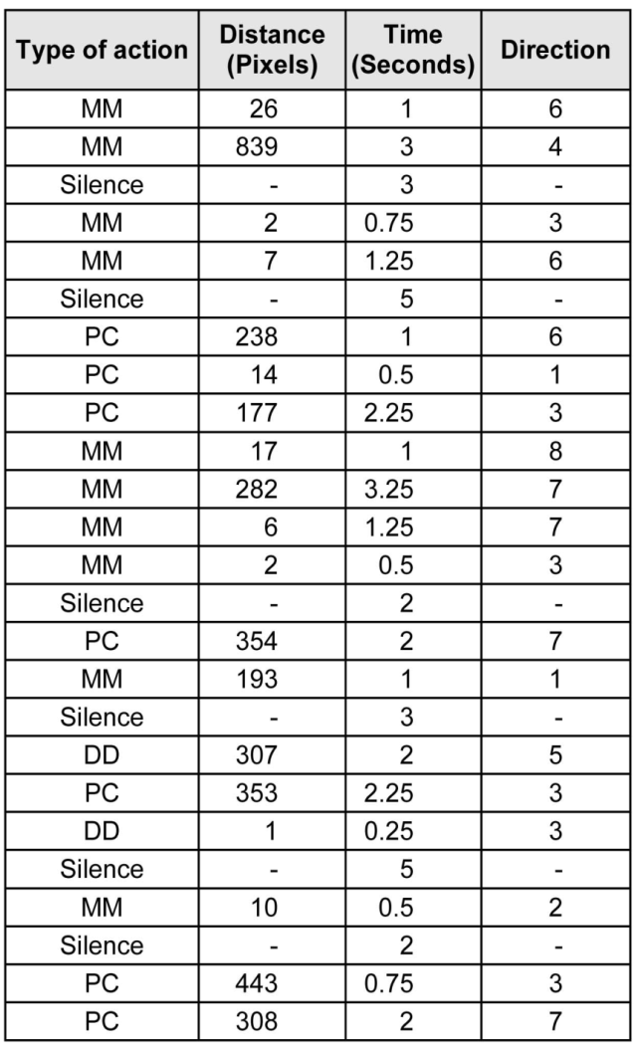
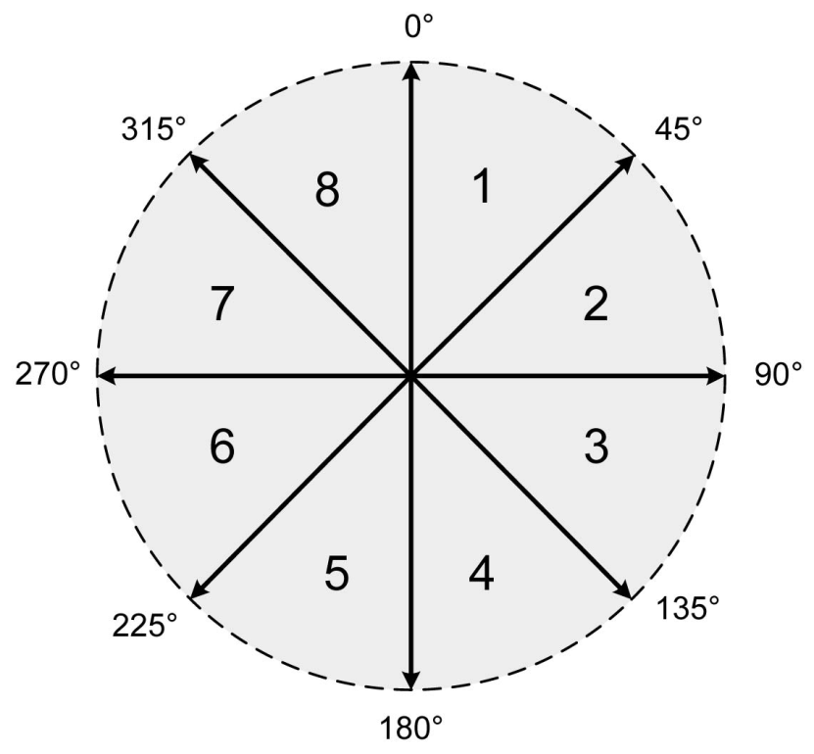
Mouse Dynamics II
A. A. E. Ahmed and I. Traore, “A New Biometric Technology Based on Mouse Dynamics,” IEEE Transactions on Dependable and Secure Computing, vol. 4, issue 3, pp 167, July-Sept. 2007.

Slide 29
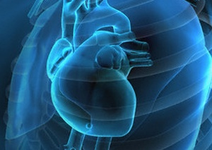
Analysis of Cardiac Sounds
Biometric identification based on cardiac sounds:
PhonoCardioGram (PCG) signals: Measures sounds from the heart
Analysis of heartbeats’ frequency, power and murmurs

Slide 30
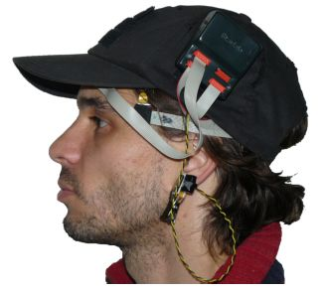
EEG/ECG
Electroencephalography: measurement and recording of electrical activity in different parts of the brain
Electrocardiography: measurement and recording of electrical activity in different parts of the heart

Slide 31
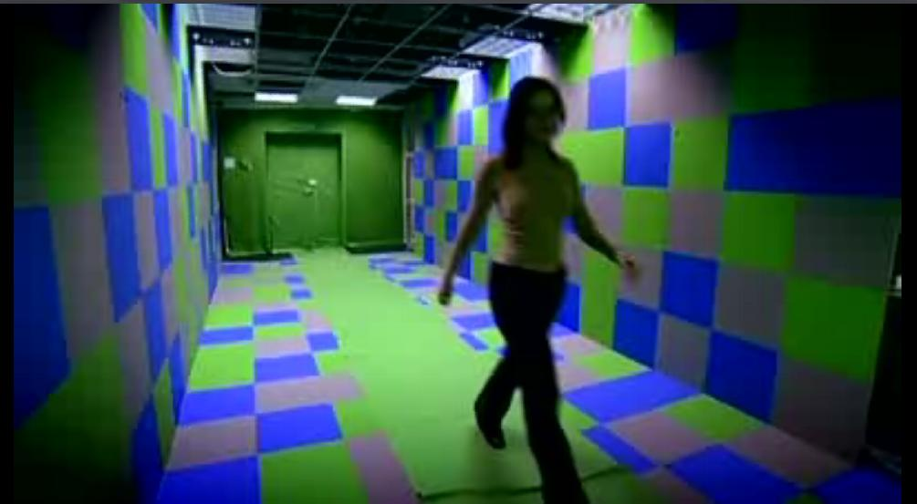
Gait Recognition
Biometrics “It’s The Way You Walk” [2:13]

Slide 32
Outline
Introduction
Biometrics Defined
Biometric System Implementation
Primary Driving Forces
Types of Biometrics
Challenges & Threats
Biometric Sensors
Privacy
Promises and Future Work
Conclusion

Slide 33
Challenges
Improve collection devices (Biometric Sensors)
Develop more efficient and effective large-scale operational capabilities (Biometric Systems)
Establish Standards for plug-and-play performance – (Biometric Systems Interoperability)
Enable informed debate on why, how and when biometrics should and can be used- (Biometrics Privacy and Security).

Slide 34
Outline
Introduction
Biometrics Defined
Biometric System Implementation
Primary Driving Forces
Types of Biometrics
Challenges & Threats
Biometric Sensors
Privacy
Promises and Future Work
Conclusion

Slide 35
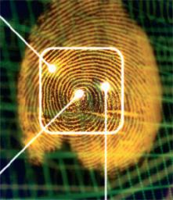
Biometric Sensors
Speech Recognition: stress, emotion, illnesses
Simple Hygiene of users may create problems
People age
Around half the population wears glasses or contact lenses
Biometric technology can injure the individual (iris recognition uses a camera and not a laser)
Facial Recognition: Twin Case?
“Much work is needed to match the reality of human behavior with the performance expected from the technology...”

Slide 36
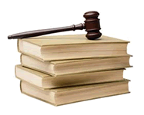
Legal Issues and Public Concerns
Does the biometric system store information enabling a person’s “identity” to be reconstructed or stolen?
What happens to the biometric data after the intended use is over?
Is the security of the biometric data assured during transmission and storage?
Notice of Biometric Use. Is the public aware a biometric system is being employed?

Slide 37
Outline
Introduction
Biometrics Defined
Biometric System Implementation
Primary Driving Forces
Types of Biometrics
Challenges & Threats
Biometric Sensors
Privacy
Promises and Future Work
Conclusion

Slide 38
Privacy
Embed privacy functionality into every layer of the architecture (Sensors to interoperable biometrics network)
Clearly document and articulate: (Privacy Assessment)
Operational purpose and scope of the proposed system
Underlying Authority of the organization
Demonstrate that all system functionality (including information sharing) is under legal authority
Privacy Acts
Personal information should only be collected if it specifically advances a legitimate purpose.
Collect minimum amount of info needed

Slide 39
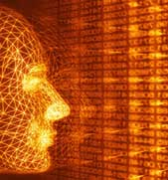
Outline
Introduction
Biometrics Defined
Biometric System Implementation
Primary Driving Forces
Types of Biometrics
Challenges & Threats
Promises and Future Work
Conclusion

Slide 40
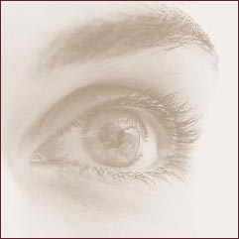
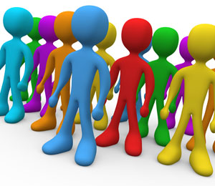
Promises and Future Work
Personalization as a Trend
Advertisements based on who you are
A door unlocks as someone approaches, activated by facial recognition
Automobile Security: My car door unlocks as I touch the door handle. No more keys, just you

Slide 41
Outline
Introduction
Biometrics Defined
Biometric System Implementation
Primary Driving Forces
Types of Biometrics
Challenges & Threats
Promises and Future Work
Conclusion

Slide 42
Conclusion
Biometric technologies are available today that can be used in security systems to help protect assets.
Future work is done extensively on behavioral biometrics since they are more robust, reliable, and personalized.
Issues for Future Research in Biometrics:
Face (Skin texture and reflectance / 3D Face)
Fingerprint @ distance
Multi-biometrics
Simulation, e.g., synthetic aging

Slide 43
Conclusion The Future of Personalization

Slide 44
Thank You For Your Attention !!
Questions
&
Answers

